Slide 1

Frequency Distributions
Chapter 2

Slide 2
Descriptive Statistics
Distributions are part of descriptive statistics…we are learning how to describe some data by first graphing it in a meaningful way.

Slide 3
Descriptive Statistics
Frequency distribution – describes the pattern of a set of numbers by displaying a count/percent for the values of the variables.

Slide 4
Frequency Distributions
Four different ways to visually describe just one variable:
Frequency table
Grouped frequency table
Frequency histograms
Frequency polygon

Slide 5
Open up R!
We are going to use some built in data in R to build frequency tables and histograms.
Use data(airquality) to load the airquality dataset
At first it will say promise next to it, but once we use it, it will pop up and be viewable in the environment window.

Slide 6
Frequency Tables
Frequency tables often include:
Values (all the possible numbers)
Frequency (how many times each number appears)
Percent/proportion
Why percent when we have frequency?

Slide 7
Frequency Tables
Grouped frequency tables are frequency tables where information has been clumped together.
For example, ABCD breakdowns instead of each grade individually. Or income ranges rather than each income separately.
Very useful for data with decimals and wide ranges of values.

Slide 8
How-To R
Frequency tables:
table(column name) function
The table function requires you to give it vector/column of data.
Remember that if that column of data is in a dataframe, then you have to tell R where the data is stored.

Slide 9
How-To R
Don’t do this:
table(airquality)
Airquality is a bunch of columns.
table(Temp)
R doesn’t know that Temp is hiding in airquality
Do this:
table(airquality$Temp)

Slide 10
How-To R
What if you wanted percentages instead of raw frequencies?
You can divide the table by N!
table(column name) / length(column name) * 100
The length() function tells you how many items are in that function.

Slide 11
How-To R
table will give you a frequency table of each individual value … what about grouping them?
stem(column name, scale = #)
Use this function to try making a stem and leaf plot, which will allow you to group like values together.
For the scale = #, try playing around with the numbers until you get the grouping you think is best.

Slide 12
Histograms
Histograms are frequency tables in graph form (basically they are turned on their side and made into a chart).
Gives you an idea of the shape of the distribution.

Slide 13
Frequency Polygon
Frequency polygons are histograms that show a smoothed line instead of the bars for a histogram.
So why use these?
They often give you a better picture of the data, since histograms can be changed based on binwidth (more on this idea in a minute).

Slide 14
Shapes of Distributions
Unimodal
(normal distribution)
Bimodal
Multimodal
Rectangular

Slide 15
Shapes of Distributions
Normal distributions: Specific frequency distribution
Bell shaped
Symmetrical
Unimodal

Slide 16
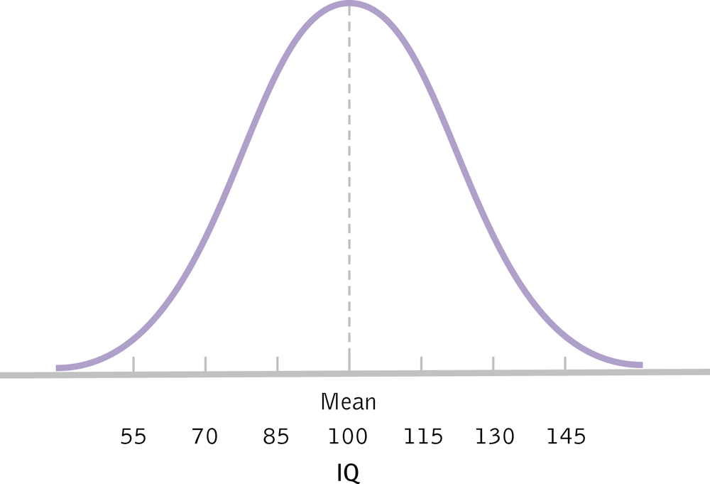
The Normal Distribution

Slide 17
Skewed Distributions
When our data are not symmetrical
Positive: tail to the right
May represent floor effects
Negative: tail to the left
May represent ceiling effects
Memory hint: skew is where the tail is (the cat!)

Slide 18
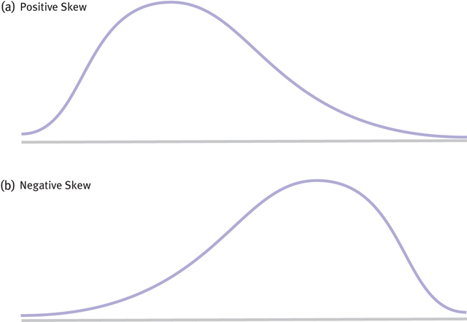
Two Kinds of Skew

Slide 19
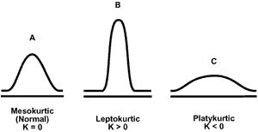
Kurtotic Distributions
Kurtosis – how much a distribution deviates from normal by looking at spread

Slide 20
How-To R
First, install the ggplot2 package.
Click packages in the bottom right window > install > type in ggplot2
Wait for it to do its thing…
Load the library
library(ggplot2)
Or you won’t get very far…

Slide 21
How-To R
Ggplot2 is a package that does lots of cool graphing, which we will use a lot in chapter 3.
It requires several steps to make a plot.
Think about it like a transparency.
You first tell it what you want to use in your plot.
Then you draw the pieces of the plot one line at a time.

Slide 22
How-To R
Basic histograms:
First, include the variables you want to use.
Save the plot.
Something like this:
myplot = ggplot(dataset, aes(column name))
Note: here because you have told it the dataset, you do not have to do the $ thing. In table(), we did because we hadn’t mentioned the dataset.

Slide 23
How-To R
Now, let’s add things to myplot
myplot + geom_histogram()
Geom_histogram creates a histogram.
Run!
Play with binwidth = X

Slide 24
How-To R
Let’s try making a frequency polygon
myplot + geom_freqpoly()

Slide 25
How-To R
So what’s a good binwidth?
5-15? (seems to work for me)

